Slide 1
Python file on Train_loan_data
Introduction.
Data Exploration.
Data Cleaning.
Feature Engineering.
Model Selection.
Model Evaluation.
Conclusion
Submitted by SANDEEP KUMAR RAI
on 05 November 2023.

Slide 2
Train_laon_data
Introduction to Train Loan Data
The train loan dataset is a collection of data related to loans issued by a financial institution. The dataset contains information such as the loan amount, term, interest rate, and borrower information. This data can be used to analyze patterns and trends in loan issuance and repayment, as well as to build predictive models to assess credit risk.
Data Sources
The train loan dataset is sourced from the financial institution's loan database.
Additional data sources may include credit bureau reports, employment history, and other financial information.

Slide 3
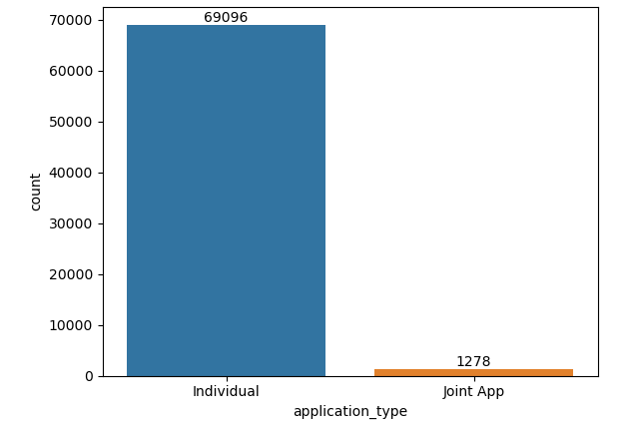
# Here we there are two types of application_type in which individual is the most with 69096 counts.

Slide 4
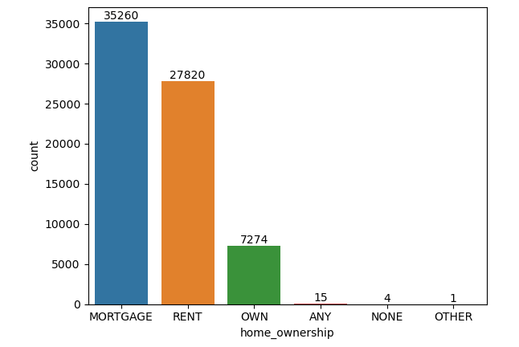
# From above data we infer that home_ownership with mortgage:35260 count , rent:27820
, and own:7274 counts are the most who have taken the loan.

Slide 5
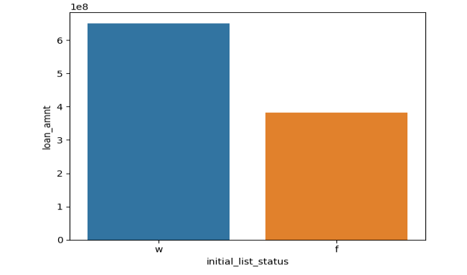
# We infer that in the initial_list_status the category “w” leads against “f” with higher loan_amnt.

Slide 6
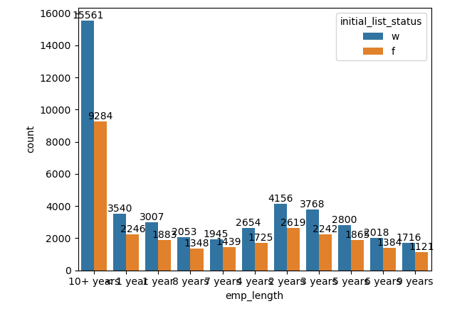
# In the emp_length category almost everywhere the initial_list_status the “w” leads against “f”.

Slide 7
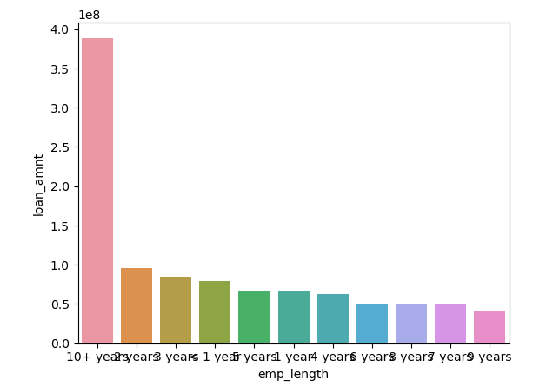
# From the above graph of emp_length loan_amnt for 10+ years is the most.

Slide 8
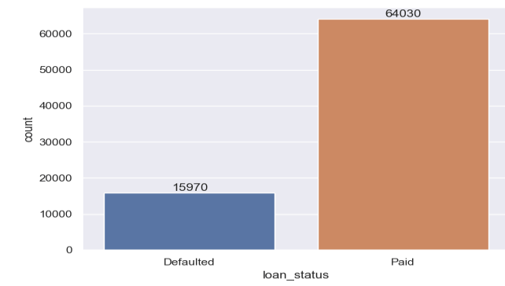
# Here the Loan_status which are paid is 64030 and the defaulted is 15970.

Slide 9
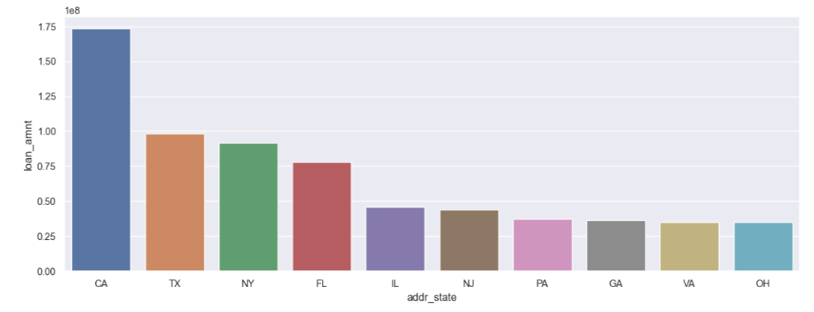
# The above data is about the Top 10 addr_states which took the loan_amnt.

Slide 10
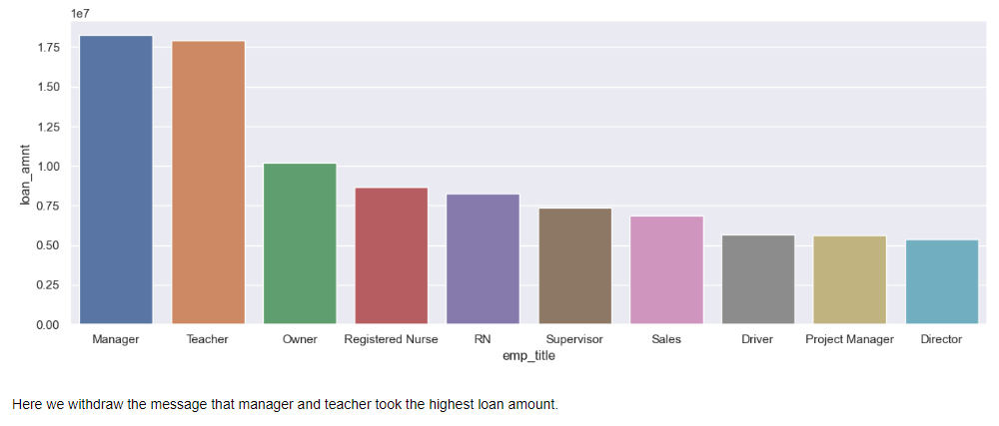
# The above data is about the top 10 emp_title who took the loan_amnt.

Slide 11
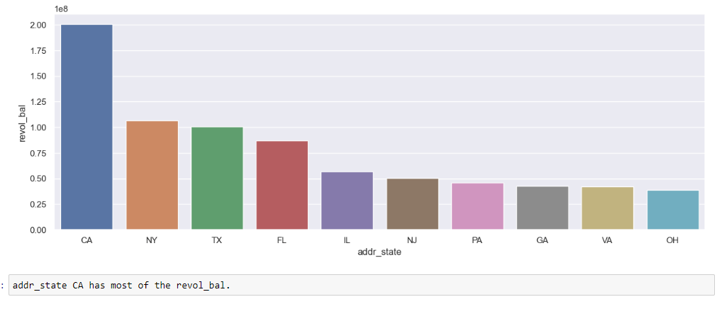
# The data states the top 10 addr_states with the revol_bal.

Slide 12
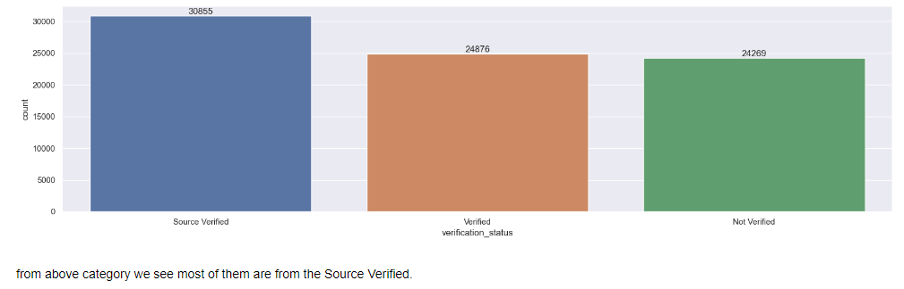
# From the above category we see most them are from the source verified.

Slide 13
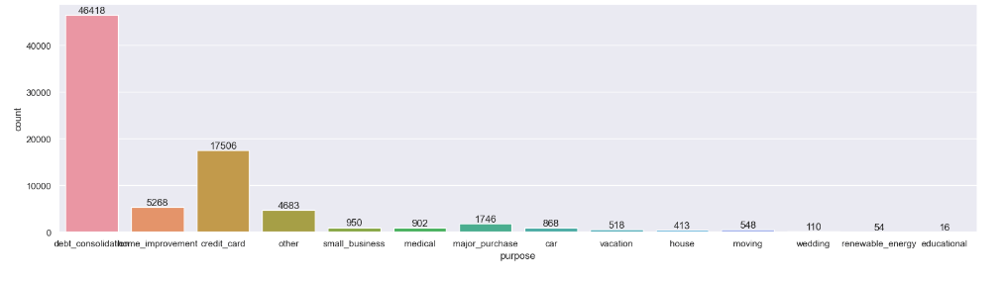
# The above is about the what are the different categories about the purpose they took loan
and their counts .

Slide 14
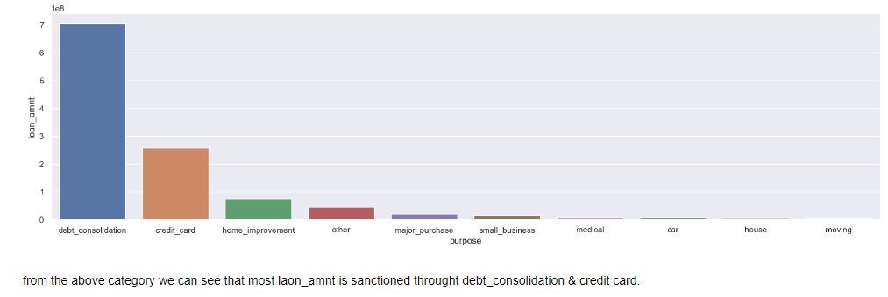
# The top 10 purpose for which the loan_amnt was disbursed.

Slide 15
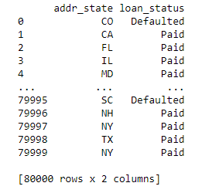
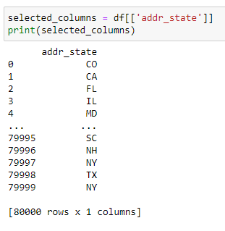
# This data infers the addr_state with the loan_status whether paid or defaulted.

Slide 16
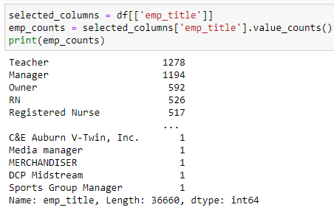
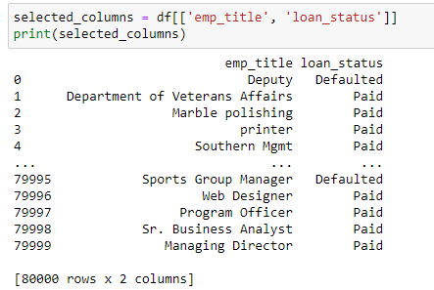
# From above it is clearly stated that different emp_title have whether paid or defaulted loan_status.

Slide 17
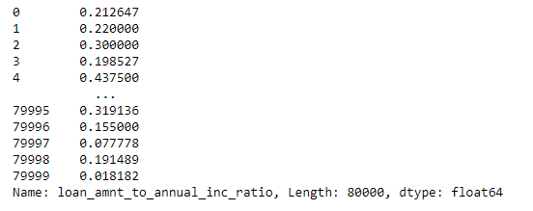
# This is the ratio of loan_amnt to annual_inc.

Slide 18
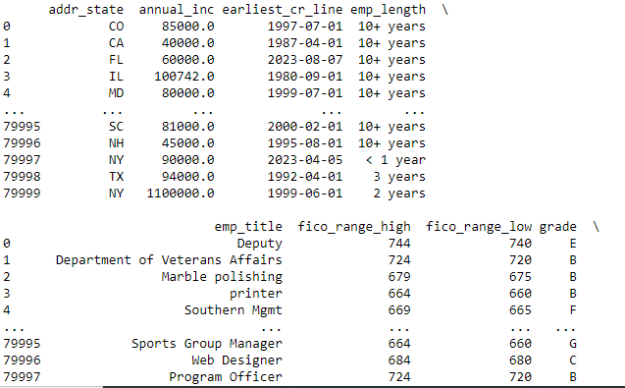
# The data collected on this page is about the purpose , continued to next two pages.

Slide 19
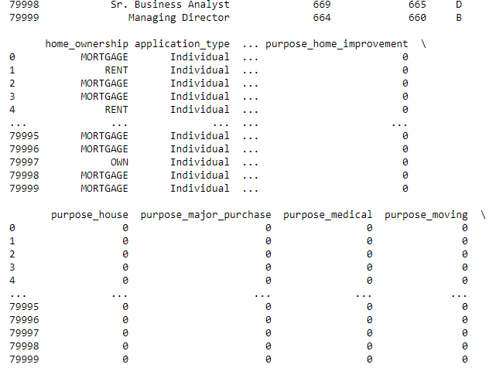

Slide 20
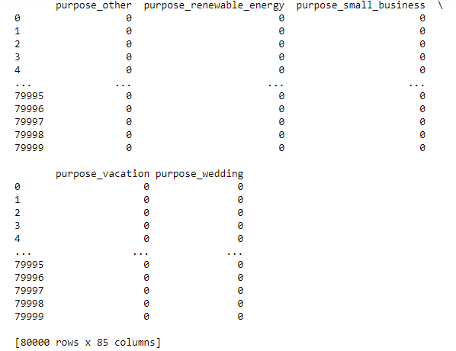

Slide 21
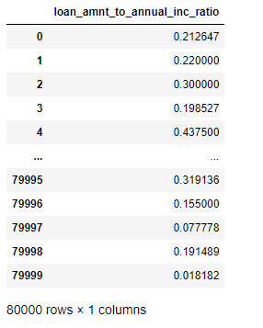
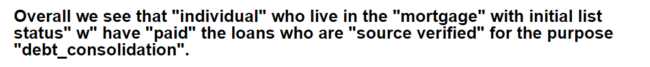
# This is the ratio of about ratio of
Laon_amnt to annual_inc.

